Slide 1

Mia, Kory, Dillon, David, Anthony

Slide 2
Concept and Inspiration
A meaningful, personal way to communicate with people effortlessly
Put in the date once, and the app does the rest
Birthdays, anniversaries, graduation, etc.
People always forget important dates
Let your friends know you care
Reminders
Pranks

Slide 3




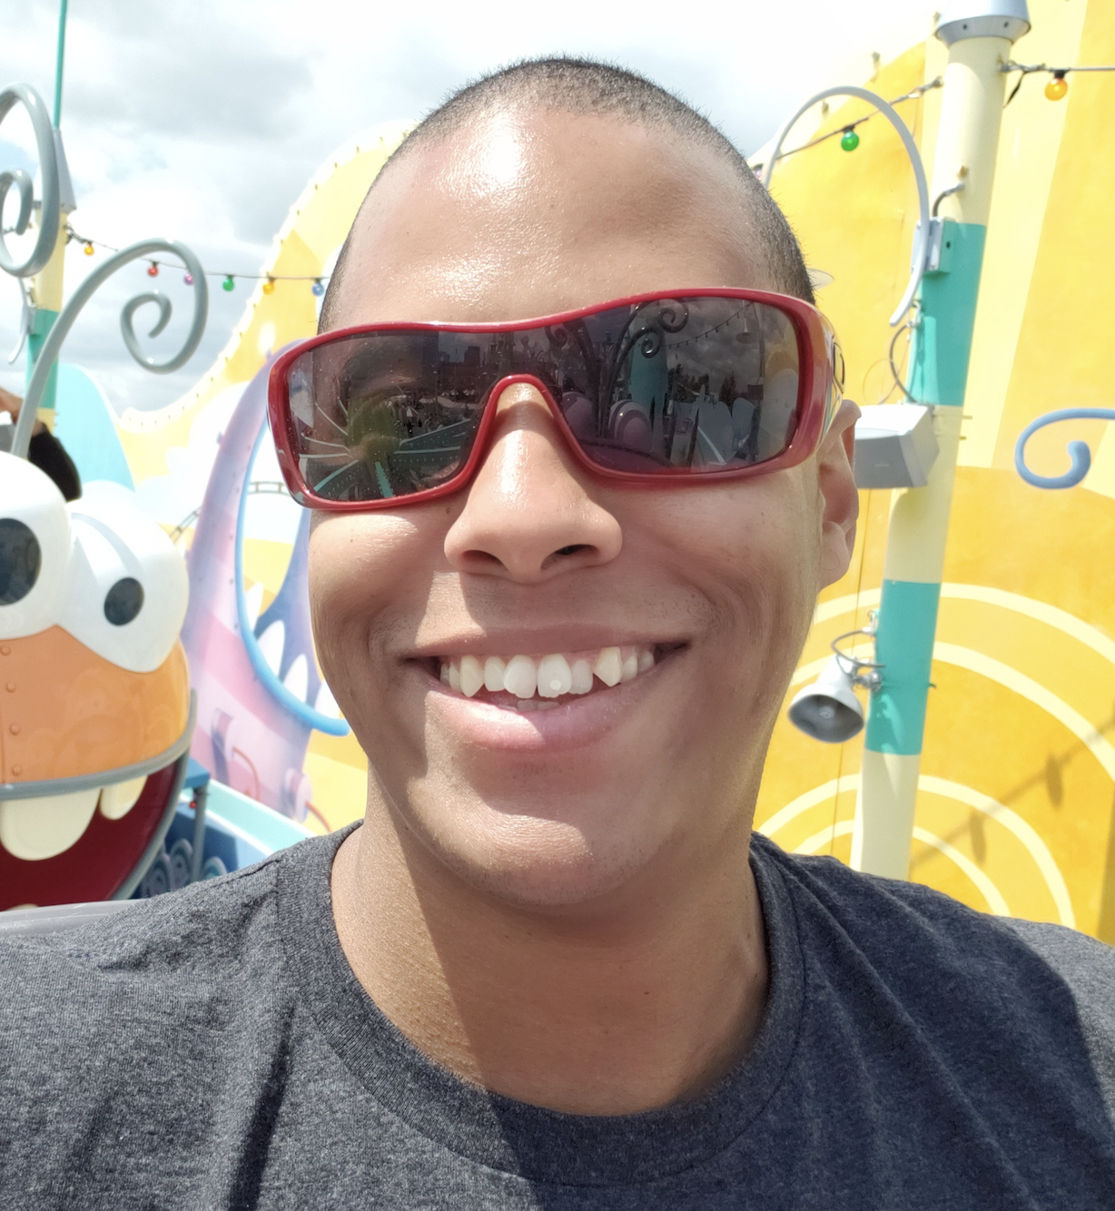
The team
Mia
David
Dillon
Kory
Anthony

Slide 4
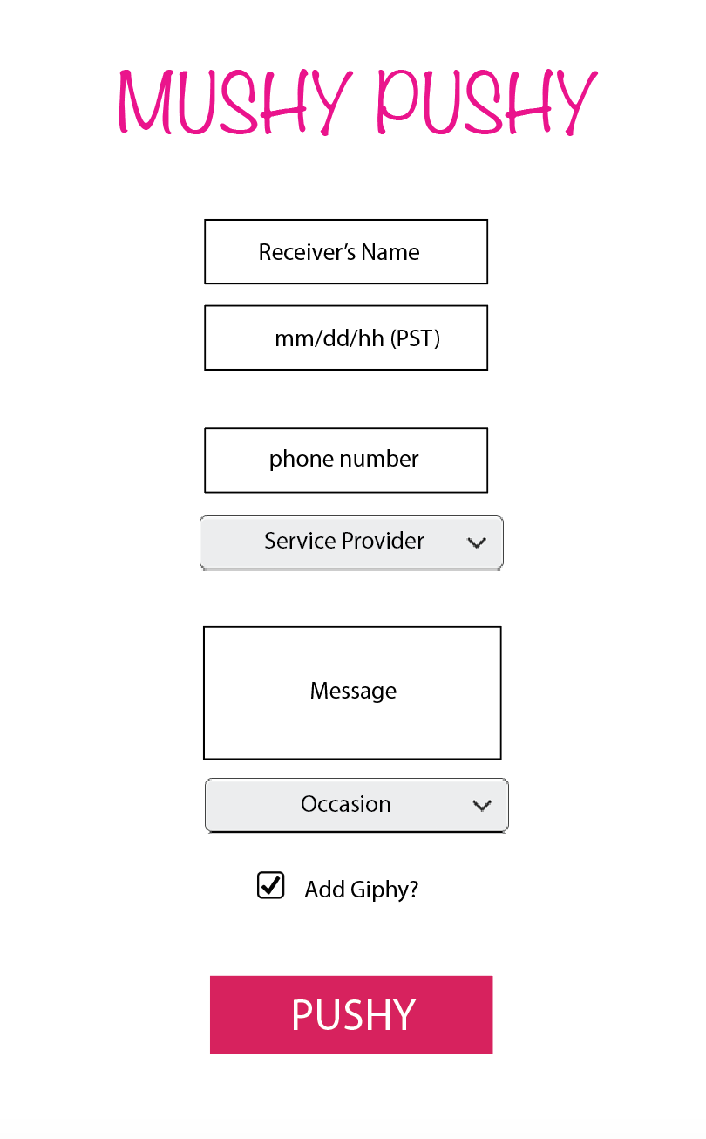
DAY1

Slide 5
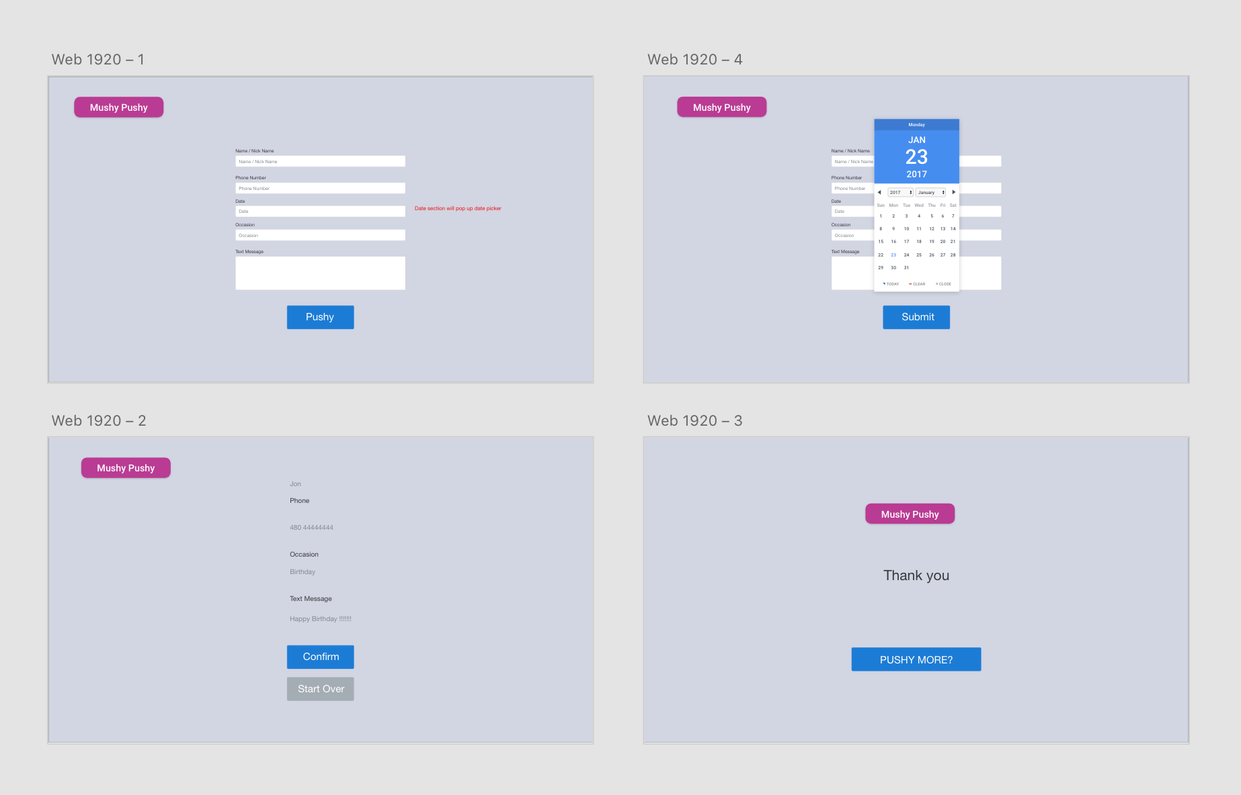
Wire frame

Slide 6
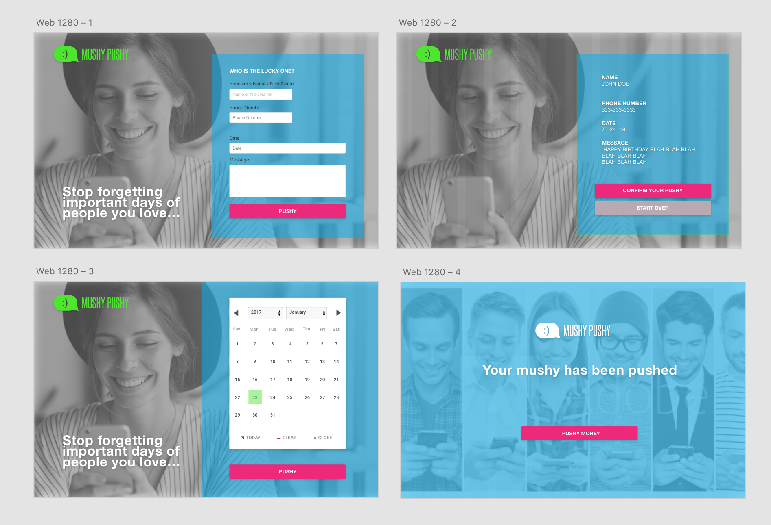
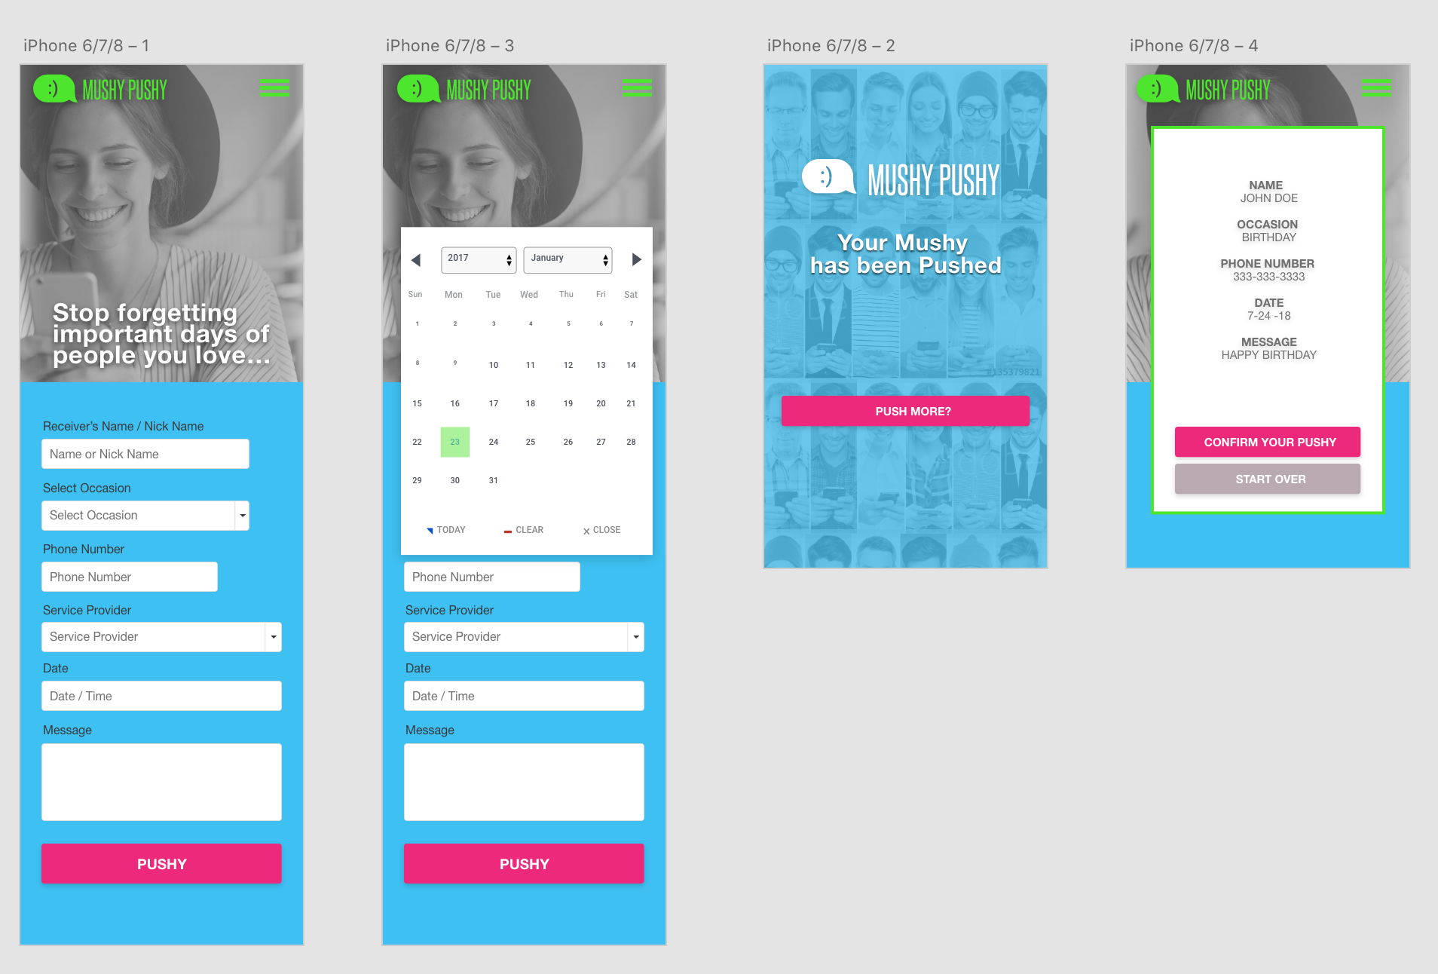
Ui design

Slide 7

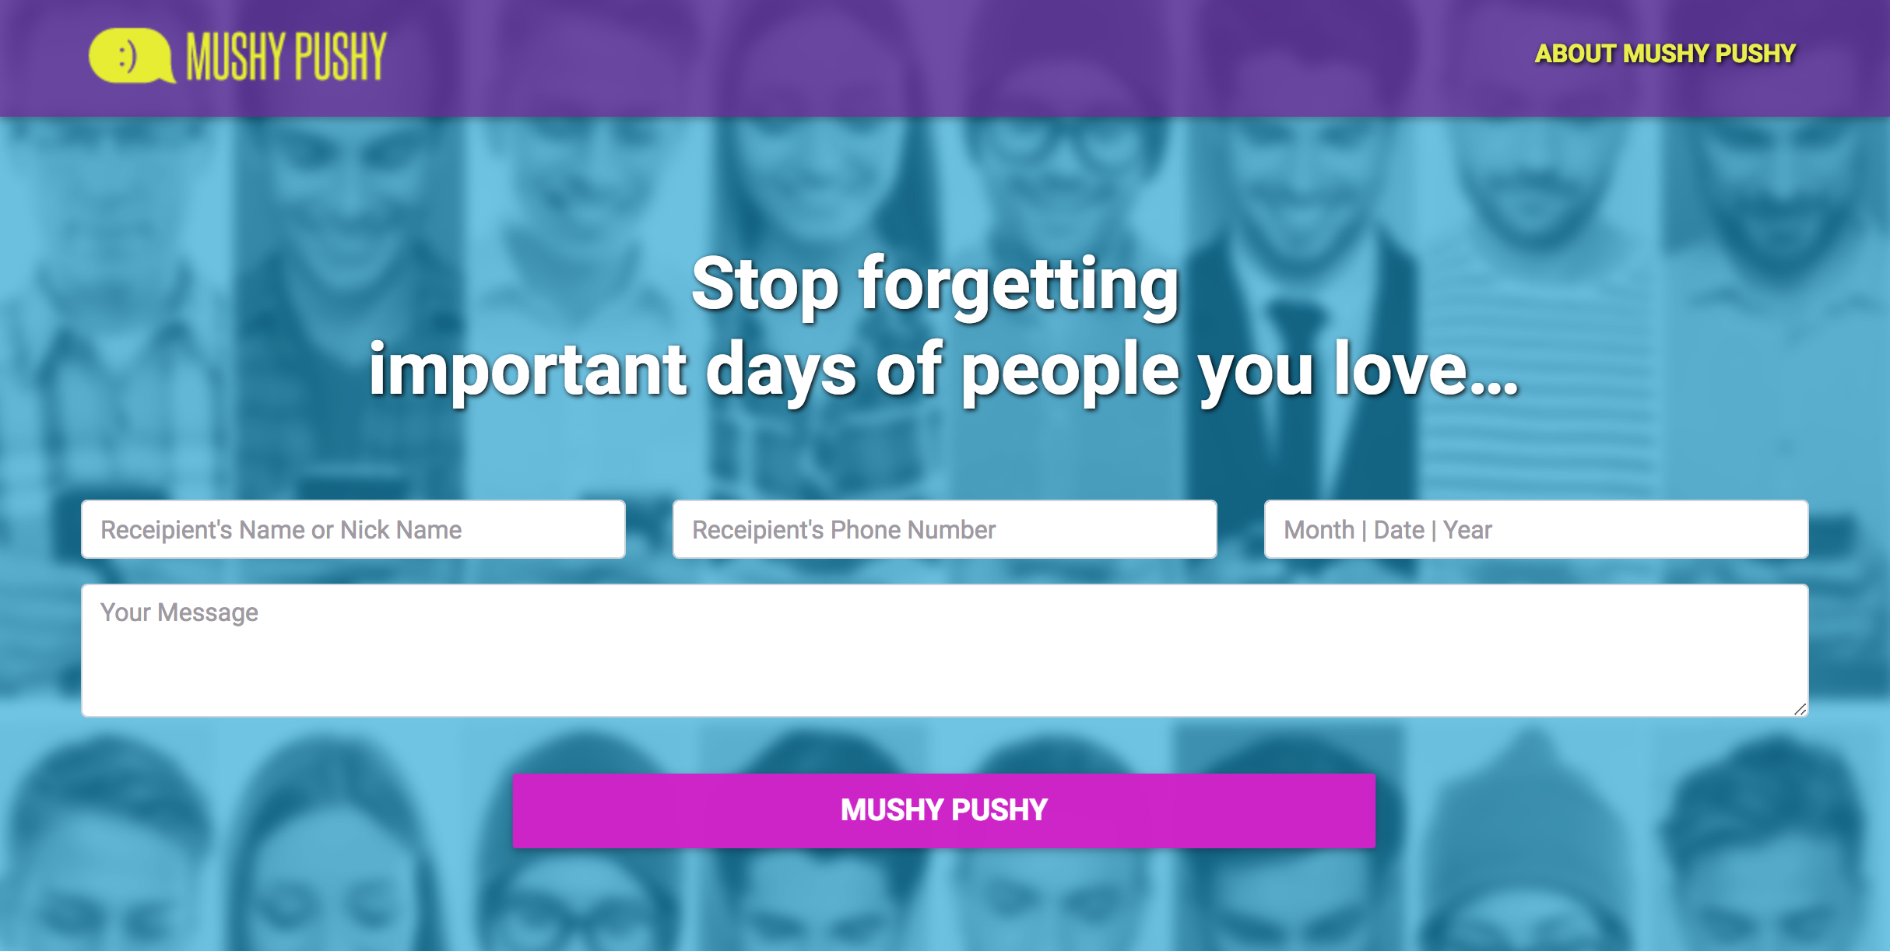
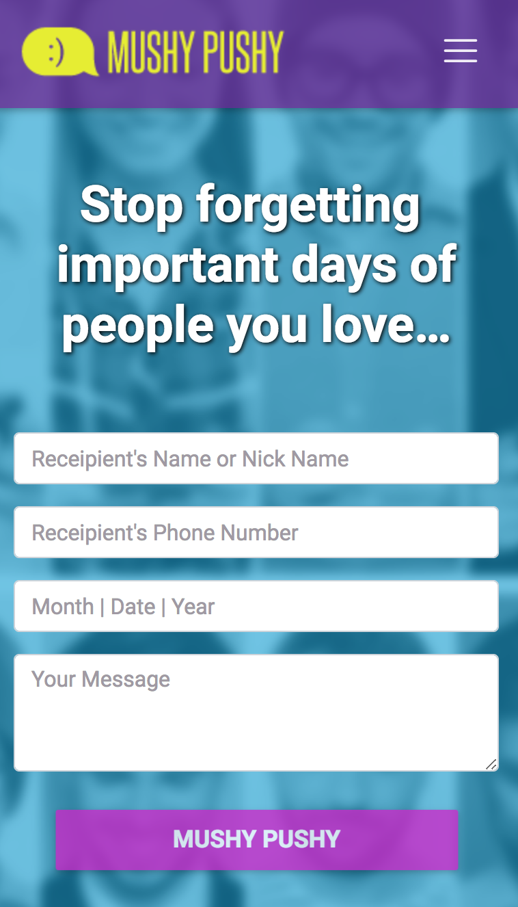

Slide 8
Tech used
Twilio
Firebase
Moment.js
Bootstrap 4.0
Adob XD – UX / UI
Form validator

Slide 9
Challenges
Date / time picker
Connecting to Twilio API
Validator

Slide 10
Demonstration…
https://teckniec.github.io/ProjectOne/

Slide 11
Future Development
Storing users specified date on server, instead of setTimeOut
With setTimeOut, closing browser erases all saved dates
User login
Send from personal number
Phone Integration
Charge Users

Slide 12
Questions?

